Slide 1

Perspector: Benchmarking Benchmark Suites
Sandeep Kumar, Abhisek Panda, Smruti R. Sarangi
Department of Computer Science and Engineering, IIT Delhi
New Delhi, India

Slide 2

Outline
Problem Statement
Notations and Experimental Setup
Desired Characteristics of Benchmark Suites
Conclusion

Slide 3
Modern Applications
Edge computing
FaaS computing
Memory advances
Blockchains
Machine Learning
IoT Devices
Need benchmarks to test any system

Slide 4
We are still using old benchmark suites
PARSEC
Multithreaded workloads
2008
NBench
Integer and Floating-point operations
1995
SPEC
CPU and Memory
1989
LMBench
System Calls
1996
Notes:
SPEC: 92 – 95 2000 2017
LMBench: 2008
PARSEC: 2011,13,14,16,18,21

Slide 5
Modern Benchmarks
How to gauge the efficacy of these new benchmark suites or any custom benchmark suite ?
Ligra
Memcached
Redis
SVM
Used in different combinations of custom benchmark suites

Slide 6
Desired Characteristics of a Benchmark Suite
Diversity
Phase changes
Coverage
Spread

Slide 7
Outline
Problem Statement
Notations and Experimental Setup
Desired Characteristics of Benchmark Suites
Conclusion

Slide 8
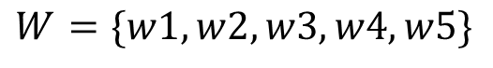
Characterization of Workloads
Measure the execution characteristics of workloads:
TLB hits, TLB misses
LLC hits, LLC misses
…
Can be any number of parameters.
Workloads vary from each other in terms of these parameters.
Figure using 2 parameters (P1 and P2).
w1
w2
Parameter space P2
w3
w5
w4
Parameter space P1
$$W=\{w1,w2,w3,w4,w5\}$$
Benchmark suite “W” containing 5 different workloads

Slide 9
PMUs or Hardware Counters (Intel)
#
1
2
3
4
5
6
7-8
9-10
11-12
13-14
PMU Counter | Description
cpu-cycles | Total CPU cycles
branch-instructions | Dynamic branch instructions
branch-misses | Branch mispredictions
dtlb_load_misses. dtlb_store_misses. walk_pending | Total #CPU cycles spent in walking the page table for the dTLB load and store misses.
cycle_activity. stalls_mem_any | Total stall cycles
page-faults | Total number of page faults
dTLB-loads &dTLB-stores | Total number of dTLB loads and stores
dTLB-load-misses &dTLB-store-misses | Total number of dTLB load and sore misses
LLC-loads & LLC-stores | Total number of LLC loads and stores
LLC-load-misses &LLC-store-misses | Total number of LLC load and store misses

Slide 10
Benchmark Suites
PARSEC
SPEC
Ligra
Suite of parallel workloads to evaluate multi-threading capabilities of a multiprocessor system.
LMBench
NBench
SGXGauge
Suite to stress the CPU and the memory subsystem.
A lightweight graph processing framework
A set of micro-benchmarks to measure the latency of different system calls.
A set of mico-benchmarks to test the speed of integer, floating-point, and memory operations.
A suite of real-world benchmarks from different domains.

Slide 11
Outline
Problem Statement
Notations and Experimental Setup
Desired Characteristics of Benchmark Suites
Conclusion

Slide 12
Diversity
Phase changes
Coverage
Spread

Slide 13

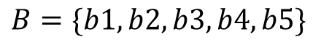

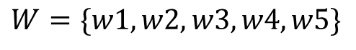
Diversity Intuition
How much more?
Suite B is more “diverse” than suite W.
b2
w1
w2
b1
Parameter space P2
w3
Parameter space P2
b3
w5
w4
b5
b4
Parameter space P1
Parameter space P1
$$W=\{w1,w2,w3,w4,w5\}$$
$$B=\{b1,b2,b3,b4,b5\}$$
Benchmark $W$suite with 5 different workloads
Benchmark $B$ suite with 5 different workloads

Slide 14
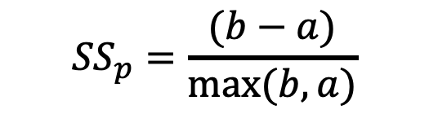
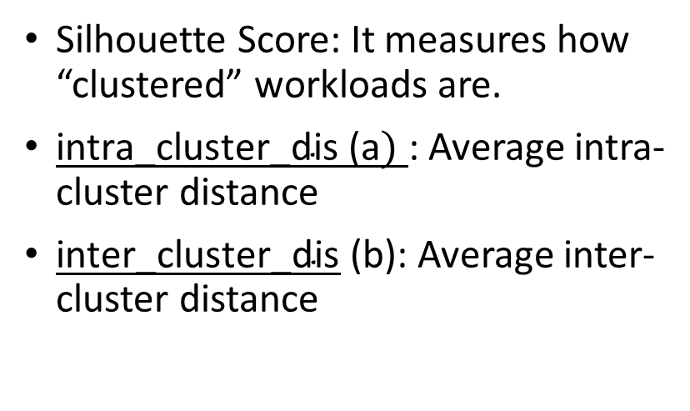
Diversity Quantification
Silhouette Score: It measures how “clustered” workloads are.
$\text{intra}\text{_}\text{cluster}\text{_}\text{dis}\text{ (}\text{a})$: Average intra-cluster distance
$\text{inter}\text{_}\text{cluster}\text{_}\text{dis}$ (b): Average inter-cluster distance
(b)
Cluster: C2
Parameter space P2
p
$${SS}_{p}=\frac{(b−a)}{max⁡(b,a)}$$
(a)
[-1 to 1]
Cluster: C1
Parameter space P1
Bad clustering (desired)
Good clustering (not desired)

Slide 15
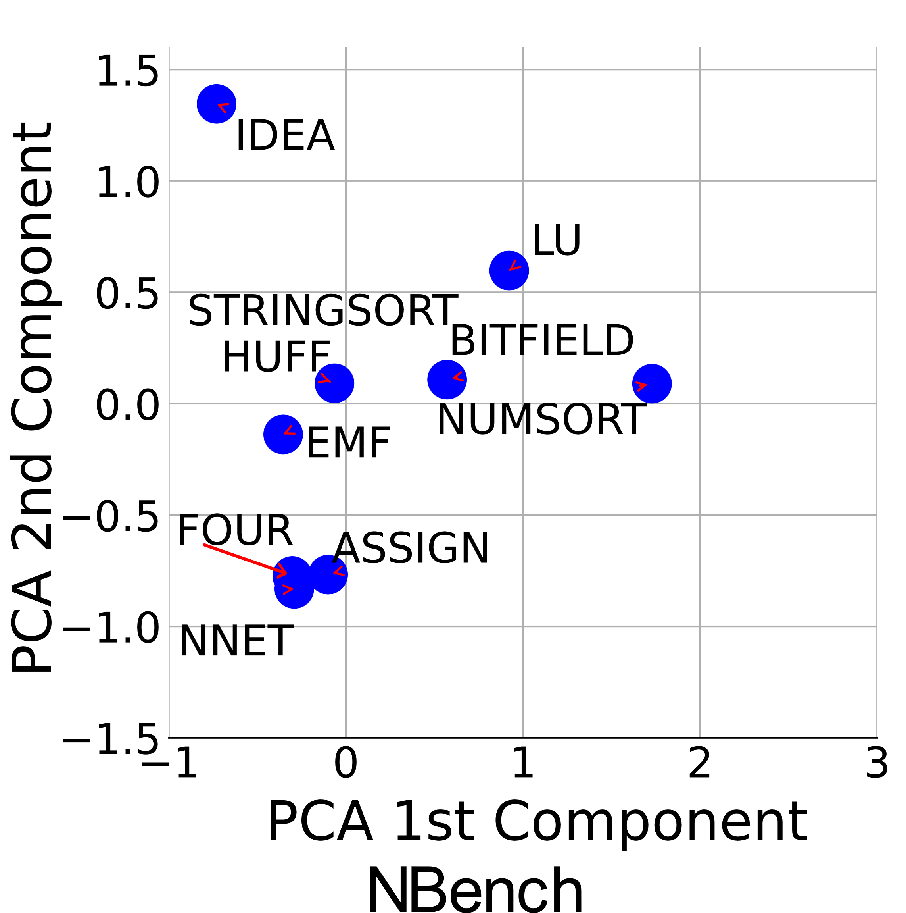
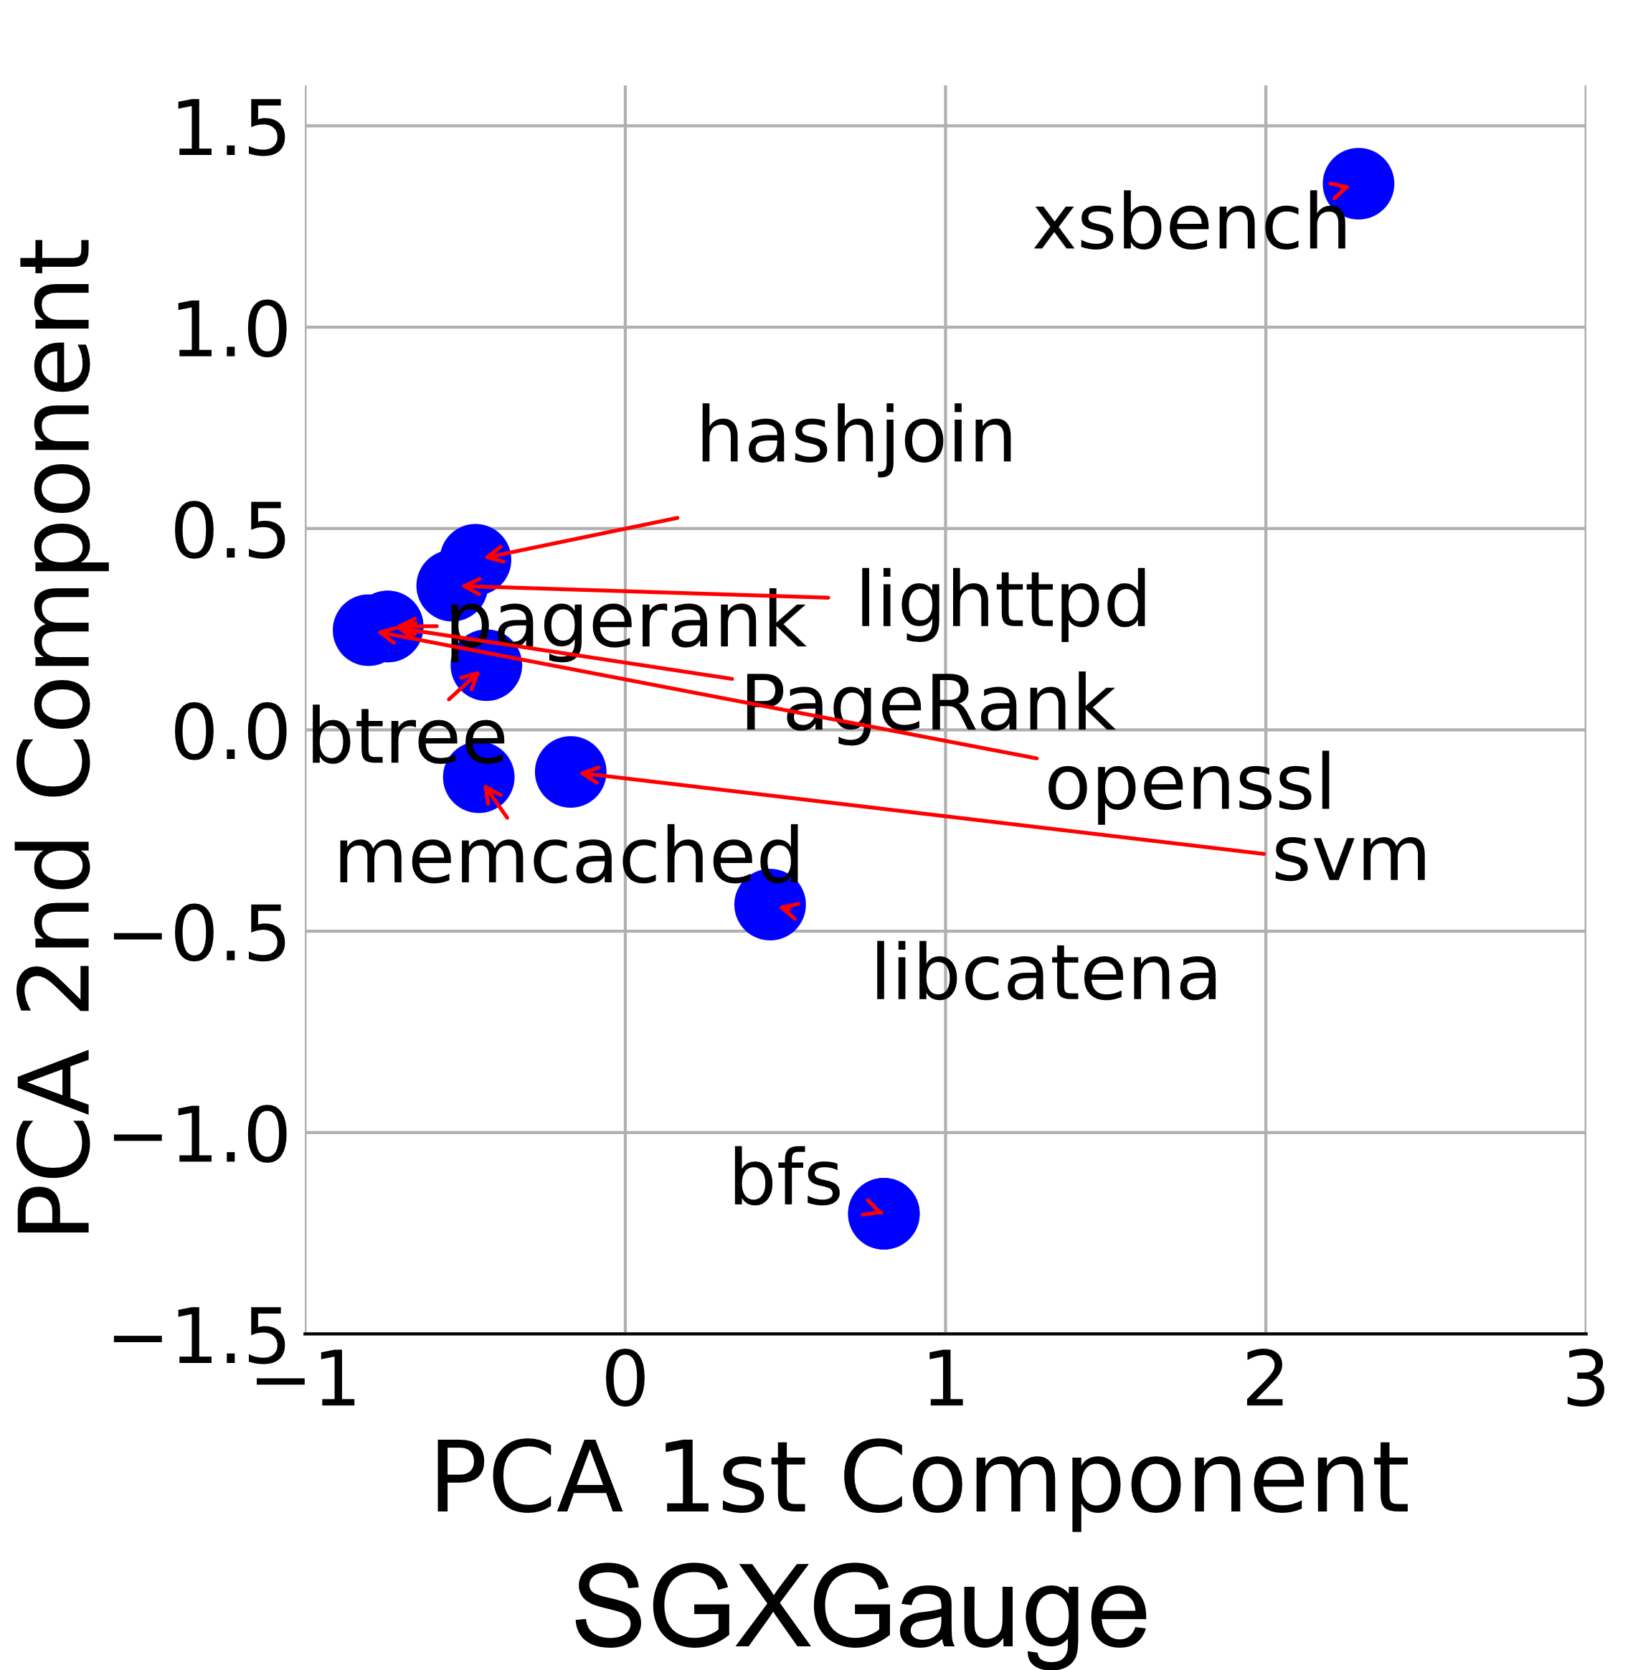
Diversity Results
NBench has a divergence score of 0.27 indicating a relative well-spread of workloads.
SGXGauge has a divergence score of .45, indicating relatively clustered workloads

Slide 16
Desired Characteristics Benchmark Suite
Diversity
Phase changes
Coverage
Spread

Slide 17
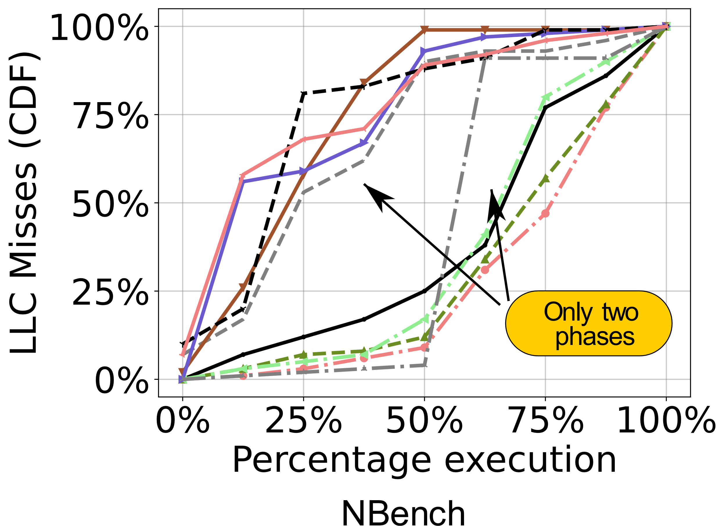
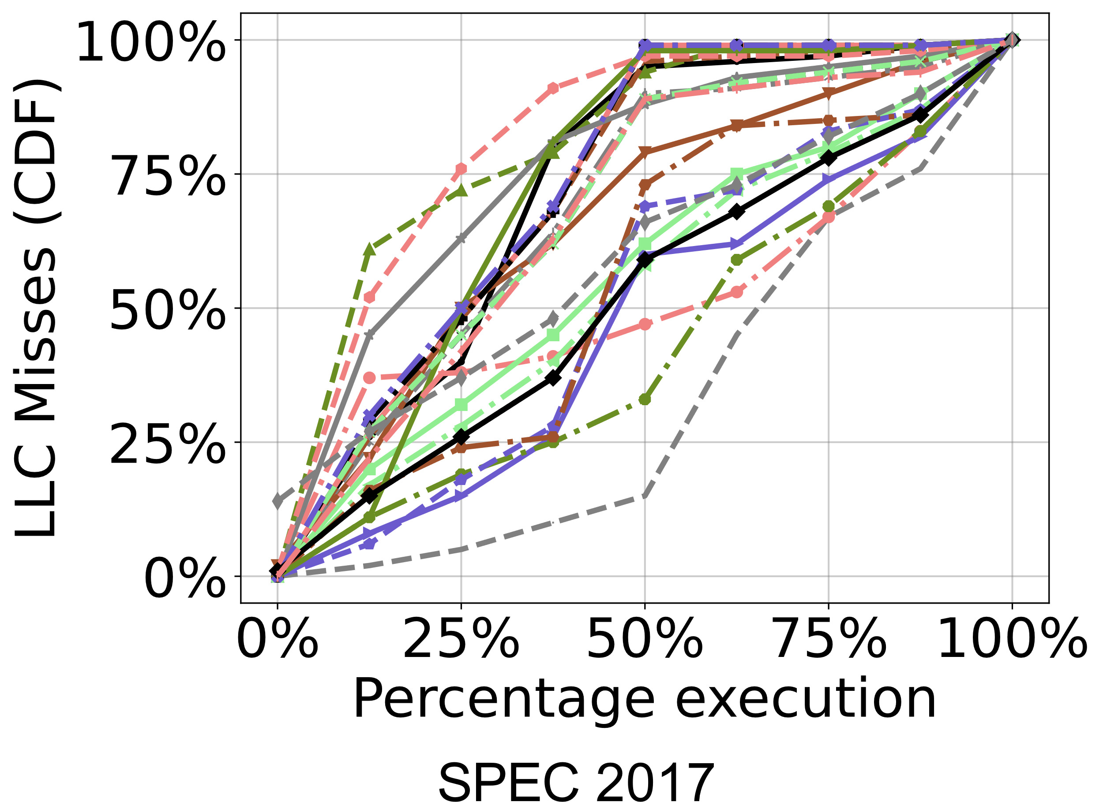
Phase Changes
In terms of time

Slide 18
Dynamic Time Warping
Better similarity score. Dissimilar desired
Parameter space P2
Parameter space P2
Point-wise Euclidean measure
Time-warped Euclidean measure
Time
Time

Slide 19
Phase Changes
NBench has a phase score of 62.66 whereas SPEC’17 has a phase score of 71.93
In terms of time

Slide 20
Desired Characteristics Benchmark Suite
Diversity
Phase changes
Coverage
Spread

Slide 21
Coverage Intuition
Suite B has more “coverage” than suite W.
b2
w1
w2
b1
w3
Parameter space P2
b3
Parameter space P2
w5
w4
b5
b4
Low
variance
High variance
Parameter space P1
Parameter space P1

Slide 22
Spread: Intuition
Suite B is more “spread” out than suite W.
b2
w1
w2
b1
w3
b3
w5
Parameter space P2
b5
Parameter space P2
b4
w4
KS-Score [0,.5]
KS-Score >.5
Skewed distribution
Uniform distribution
Parameter space P1
Parameter space P1

Slide 23
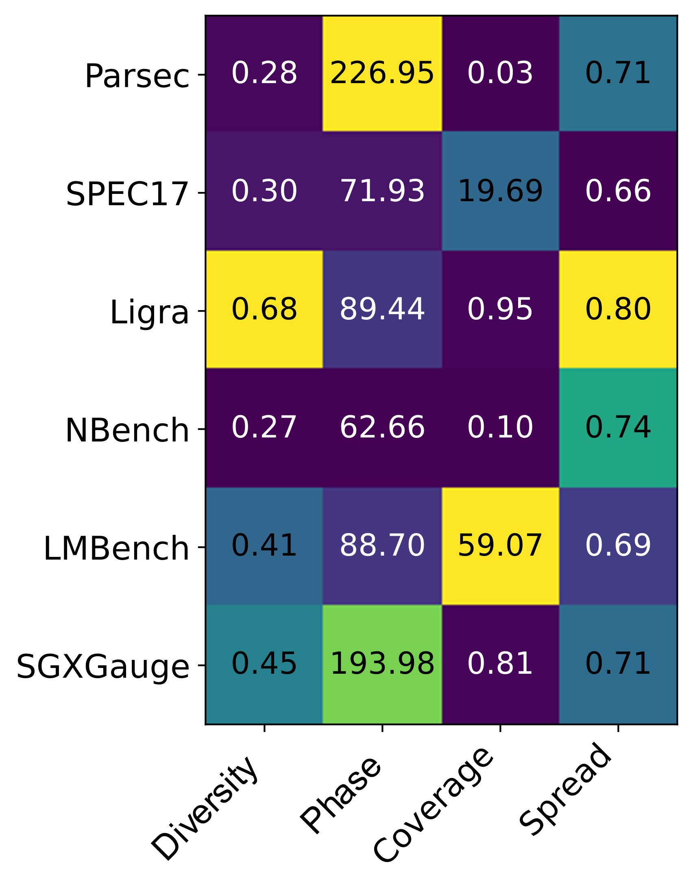
Results
Lot of phase changes in PARSEC
Low diversity in Ligra
Uniform distribution in SPEC
High coverage in LMBench

Slide 24
Use-Case: Subset Generation
w2
w8
w3
w2
w7
w4
w1
w10
w8
Parameter space P2
Subset 1
Which one is better?
w5
w6
w3
w9
w7
w4
w1
w10
w5
w6
Parameter space P1
w9
Subset 2

Slide 25
Outline
Problem Statement
Notations and Experimental Setup
Desired Characteristics of Benchmark Suites
Conclusion

Slide 26
Conclusion
Introduced four rigorously defined metrics to measure the efficiency of a benchmark suite.
Using the metrics, we evaluated the performance of some of the most widely used benchmark suites.
We also showed how the benchmark suites fare when we focus on only a particular set of microarchitectural events.
We also showed where they stand with respect to each other, and how to effectively choose a representative subset of a benchmark suite.

Slide 27
Thank You!
Contact:
Sandeep Kumar: sandeep.kumar@sit.iitd.ac.in
Smruti R. Sarangi: srsarangi@cse.iitd.ac.in

